Slide 1


COMPUTER GRAPHICS LAB
Dynamic City
Scenery Visualization
Using OpenGL
THE STRAW HATS

Slide 2

Zadid Al Lisan 221-15-5426

Slide 3
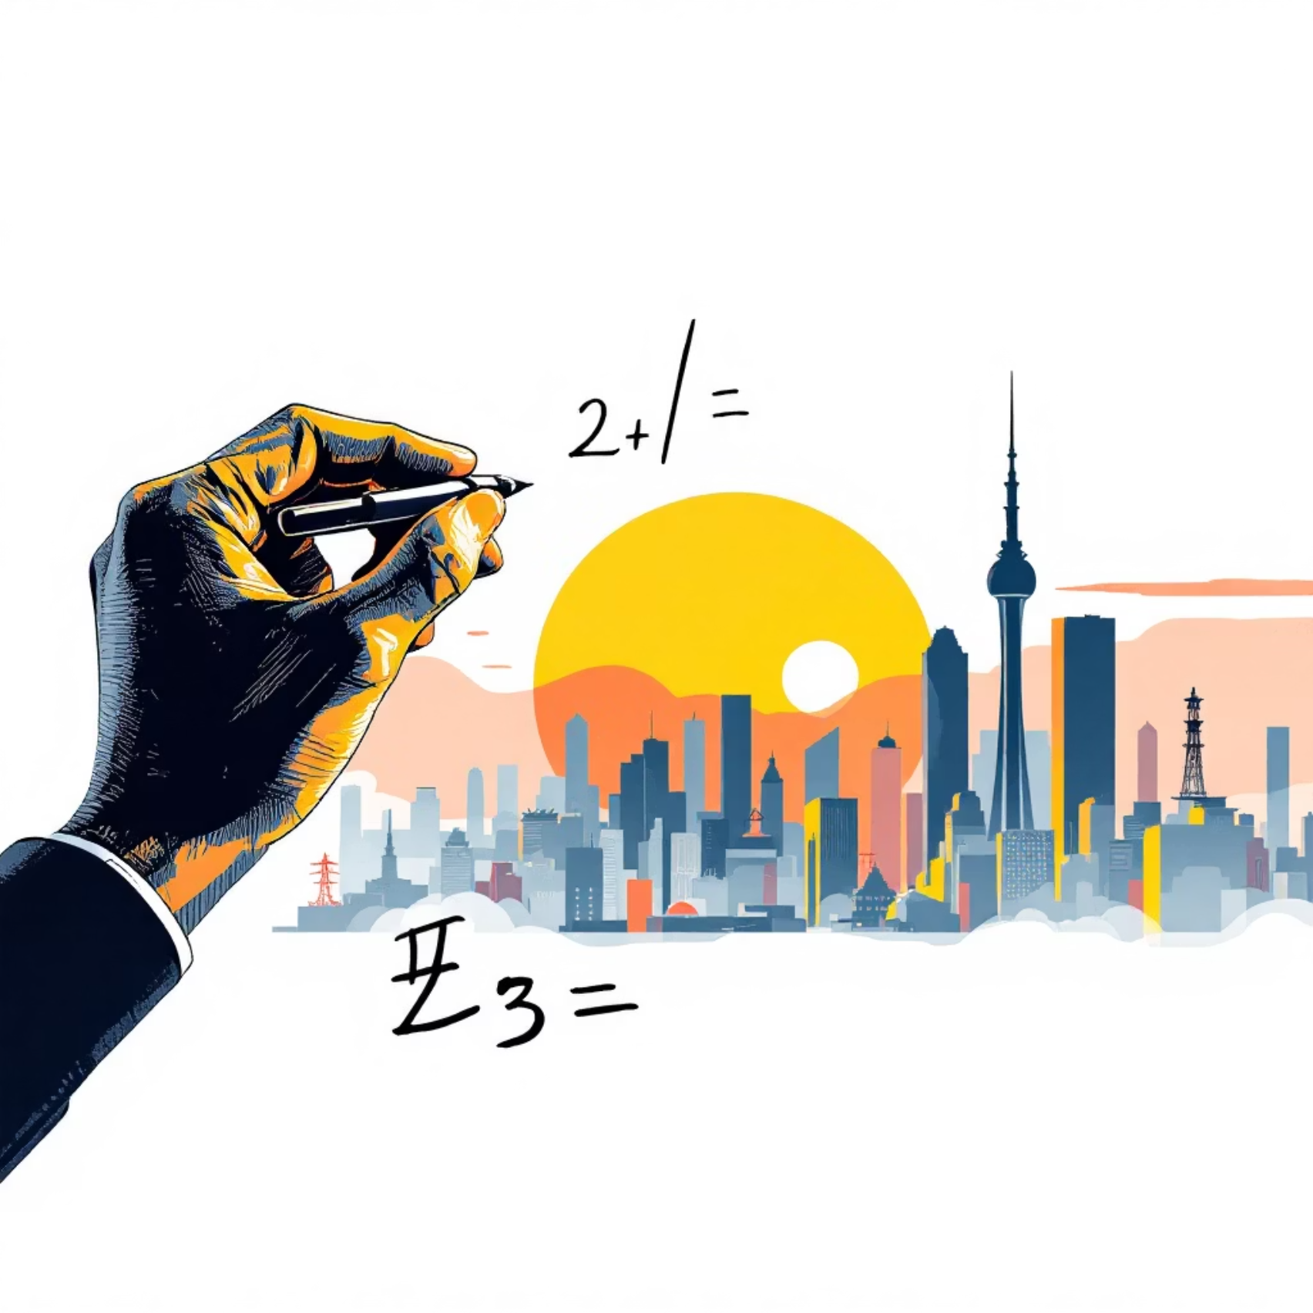
Project Motivation: From Formulas to Worlds
The "Why": Transitioning from abstract mathematical formulas to interactive visual systems.
Bridging the Gap: Moving beyond static 2D images to a dynamic, multi-layered city environment.
Real-world Context: Developing a virtual city environment to simulate the urban infrastructure.

Slide 4

Core Objectives: Building a Dynamic City
1
2
Algorithm Implementation
Animation Goals
Mastering DDA,
Bresenham, and
Midpoint Circle algorithms
for pixel-level precision in drawing lines and curves.
Applying transformations like
rotation,
scaling, and
shearing
for realistic motion, such as swaying trees and rotating wheels.
3
User Experience
Developing a responsive UI with keyboard controls for environment toggling

Slide 5

Showrav Das 221-15-5425

Slide 6
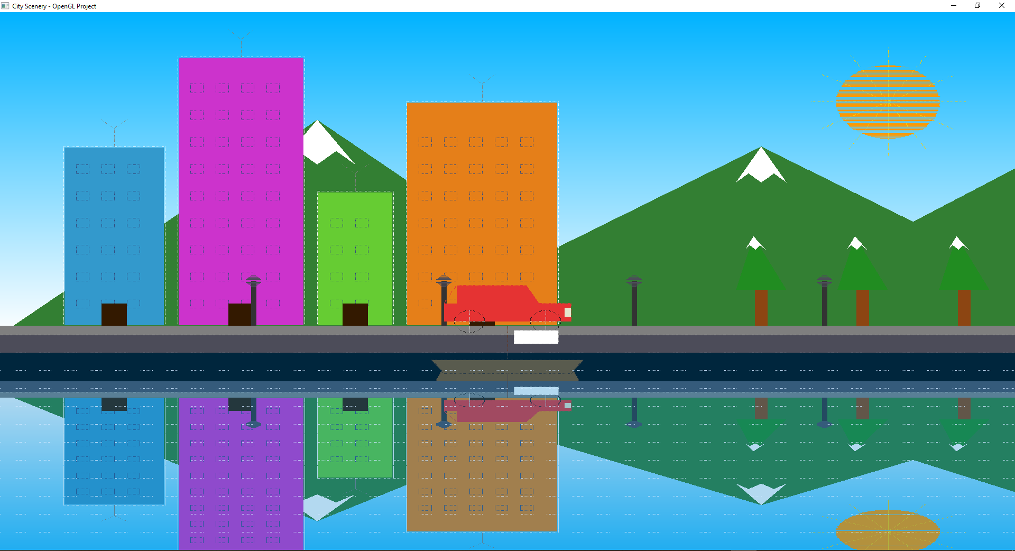

Utilizing layered rendering where objects move from background to foreground to create depth.
Scene Overview: Layers of Life
Components:
Gradient sky, snow-capped ranges, atmospheric stars.
Depth Management:
Utilizing layered rendering where objects move from background to foreground
to create depth.
Environmental Detail:
atmospheric touches like stars, street lamp halos, and animated water
flow lines

Slide 7
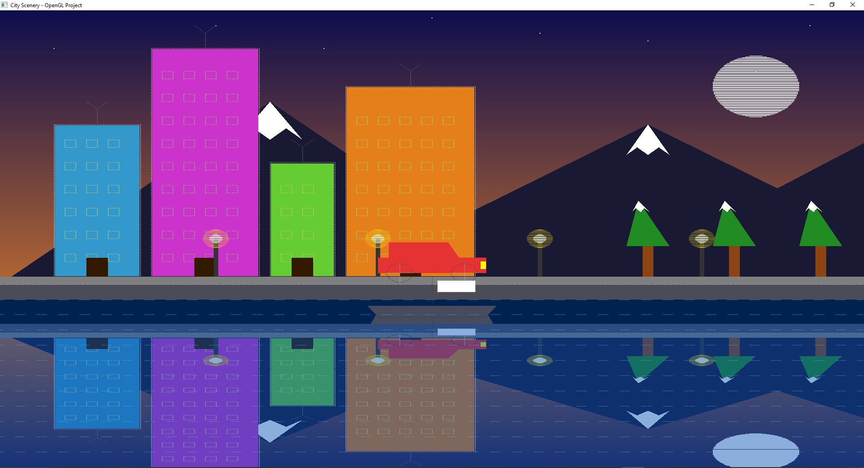

Interactive Features: Bringing the City to Life
Experience a city that responds to your commands. Toggle between day and night, control traffic, and activate natural phenomena with simple key presses.
Day/Night Transition: 'D' for day, 'N' for night – watch the sky transform.
Vehicle Control: Arrow keys for movement, 'C' for high-speed cruising.
Image: Day View
Dynamic Elements: 'B' key activates boat animation, swaying trees simulate wind.
Image: Night View

Slide 8

Adnan Rahman Sayeem
221-15-5505

Slide 9
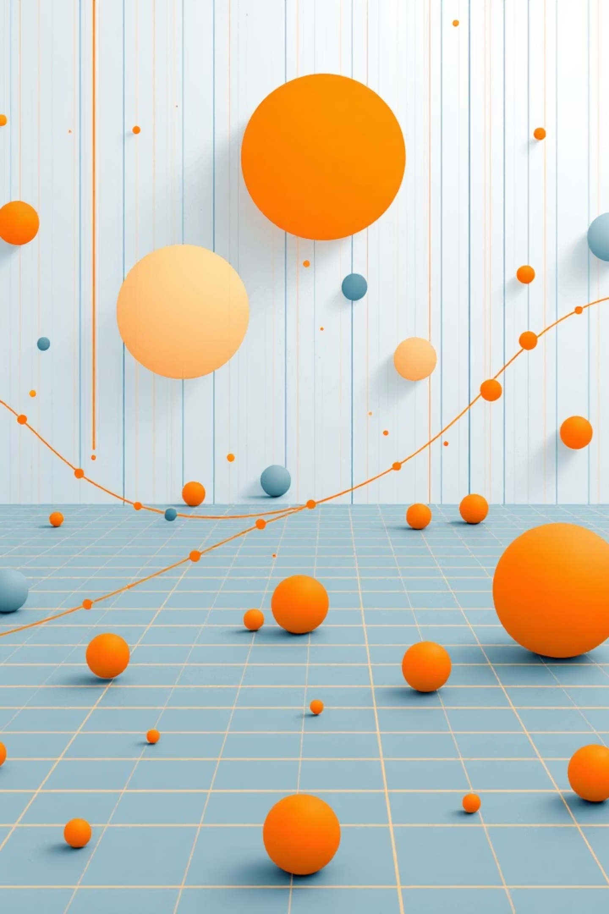
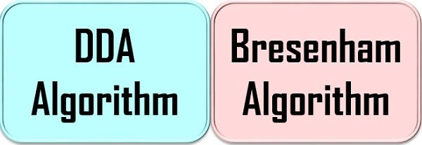
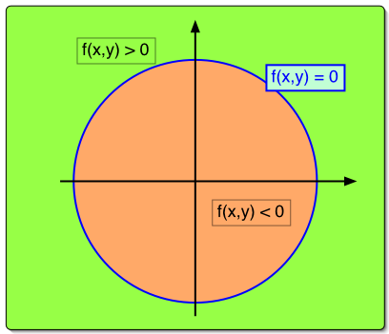
Geometric Algorithms: Precision in Pixels
Bresenham’s Algorithm
1
Efficient integer-only arithmetic for crisp building outlines and roads.
Midpoint Circle Algorithm
2
Smooth, non-jagged edges for wheels and celestial bodies.
DDA Algorithm
3
Flexible line drawing for varied graphical needs.

Slide 10
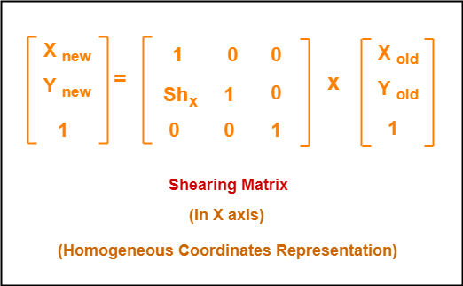

Transformation & Animation: Dynamic Motion
Matrix Management: Using glPushMatrix/glPopMatrix to isolate object movements.
Shearing for Sway: Custom 4x4 matrix for realistic tree swaying effects.
Timing Precision: glutTimerFunc at 16ms for consistent 60 FPS performance.

Slide 11
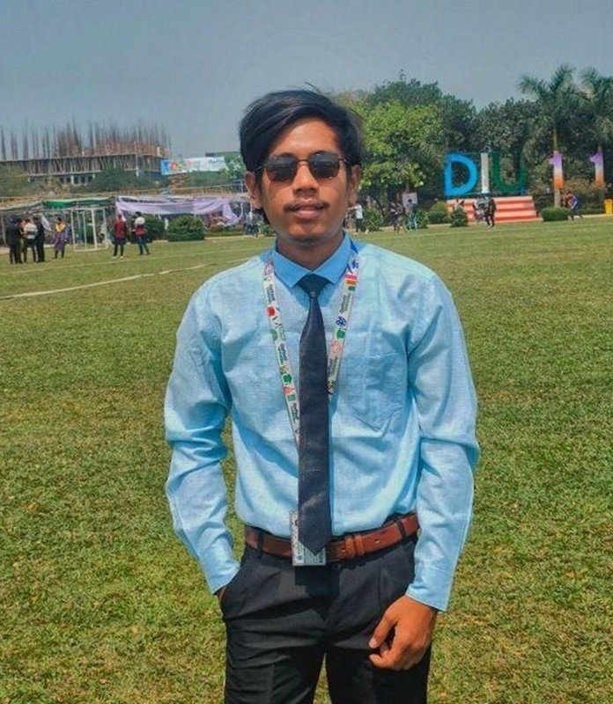
Aong Sing Marma
221-15-6050

Slide 12
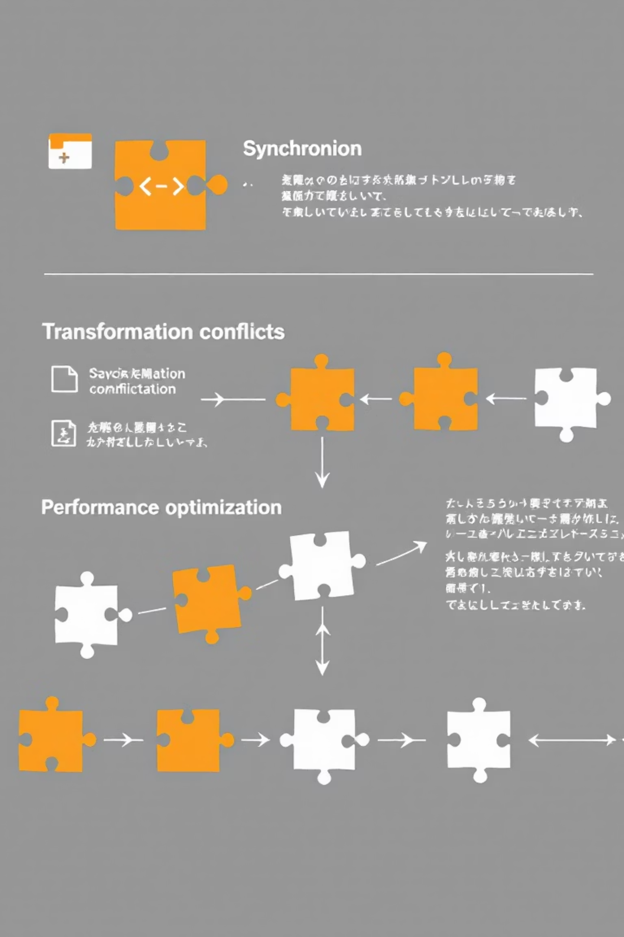

Challenges & Solutions: Overcoming Hurdles
Synchronization Issues
1
Problem: Coordinating multiple animations (water, wheels, trees).
Solution: Centralized timer callback for seamless integration.
Transformation Conflicts
2
Problem: Unintended object movements due to shared matrices.
Solution: Strict matrix stack management for isolated transformations.
Performance Bottlenecks
3
Problem: Maintaining high frame rates with complex scenes.
Solution: Optimizing rendering by minimizing state changes.

Slide 13

Complex Reflection Implementation
Achieving visual realism meant going beyond simple mirroring. We implemented a sophisticated reflection system for the water surface
Visual Realism:
1
0.6 scaling factor and semi-transparent overlay for depth.
Mathematical Foundation:
2
Using glTranslatef and glScalef to accurately flip and "squash" the scene onto
the water.
Dynamic Water Effects
3
Adding animated dashed lines to the reflection to simulate flow.
Figure: Water reflection

Slide 14

Niloy Biswas 221-15-5894

Slide 15







Impact & Sustainability: Building for the Future
Our project is not just about technology; it's about creating sustainable and ethical solutions for education.
Ethical Design
Adhering to academic integrity and inclusive UI.
Modular Code
Ensuring long-term maintenance and function reuse.
Digital Learning
Reducing waste with paperless educational tools.

Slide 16

Limitations & Future Work: Expanding Horizons
Current Boundaries
2D constraints, basic keyboard-only interaction, lack of image texturing.
Next Frontier: 3D
Migrating to GLSL shaders, particle systems (rain/snow).
Intelligent Worlds
Implementing AI-controlled traffic for dynamic environments.
Platform Expansion
WebGL and Mobile (Android/iOS) for wider accessibility.

Slide 17
COMPUTER GRAPHICS LAB
THANK YOU!
THE STRAW HATS

